Slide 1
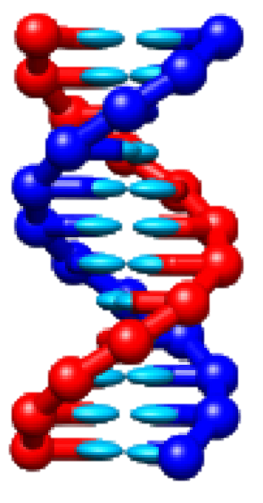

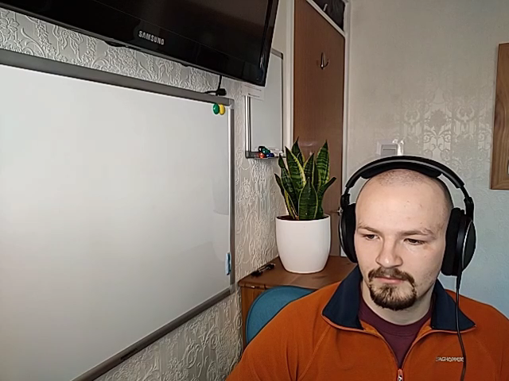

Performance Enhancement of the
LAMMPS CG‐DNA
Package
X THE PLACE OF USEFUL LEARNING
Lewis M Russell (SN: 201817988)
Supervisor: Dr Oliver Henrich
Date | 31/01/2022

Slide 2
Molecular Dynamics
Analysis of Atom/Molecule Physical Movement
Based of Newtons Laws

Slide 3
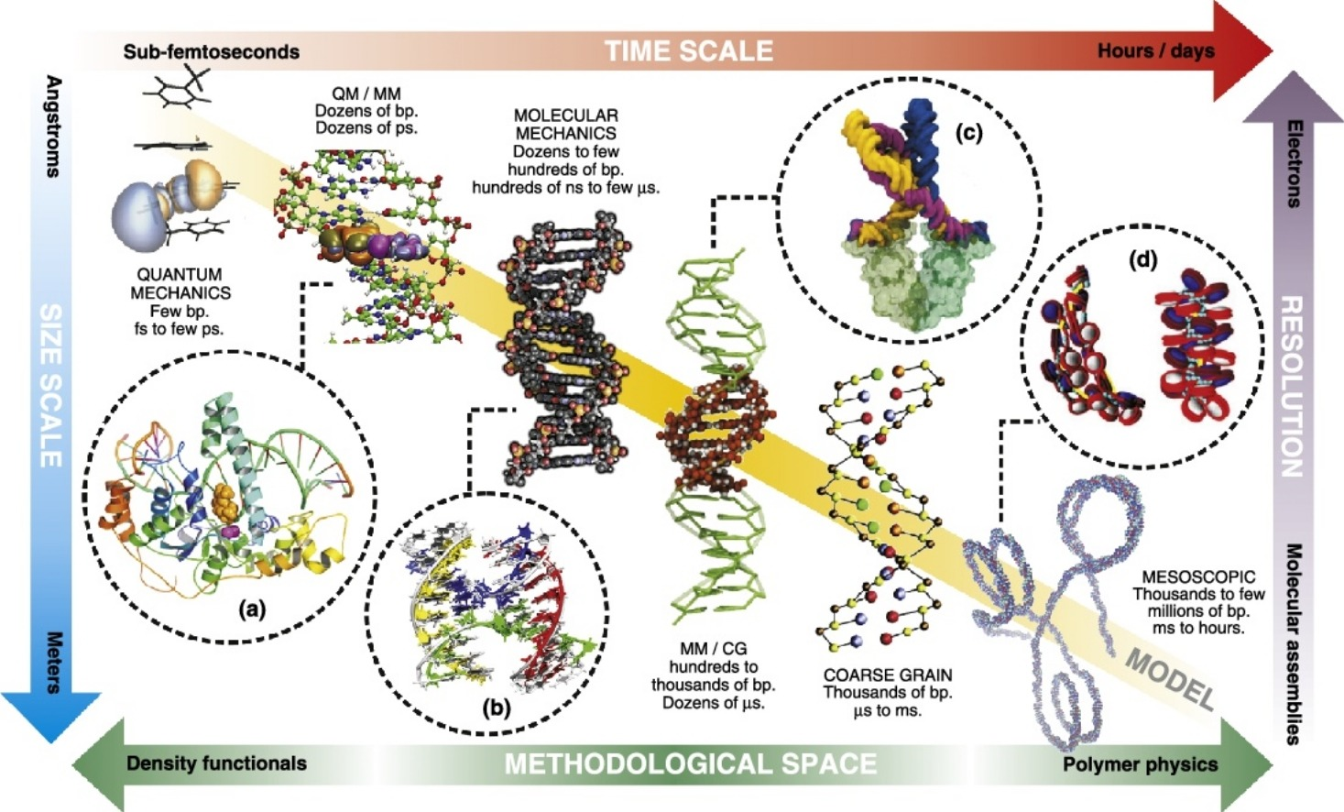
Coarse-Grain Modelling
*
*Figure From:
Pablo D Dans, J¨urgen Walther, Hansel G´omez, and Modesto Orozco. Multiscale simulation of dna. Current opinion in structural biology, 37:29–45, 2016.
oxDNA / CG-DNA

Slide 4
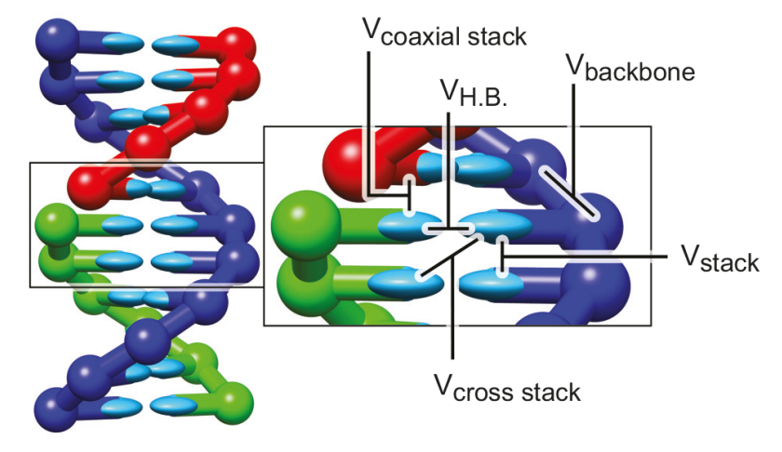
Coarse-Grain Modelling
*
*
*Figure From:
Petr Sulc, Flavio Romano, Thomas E Ouldridge, ˇ Lorenzo Rovigatti, Jonathan PK Doye, and Ard A Louis. Sequence-dependent thermodynamics of a coarsegrained dna model. The Journal of chemical physics, 137(13):135101, 2012.

Slide 5
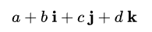
The Improvements
Quaternion to Cartesian Co-ordination Conversions
Extension of Complex Numbers ->

Slide 6
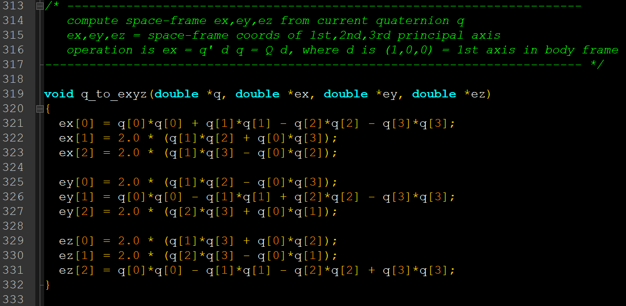
Quaternion to Cartesian Co-ordination Conversions

Slide 7
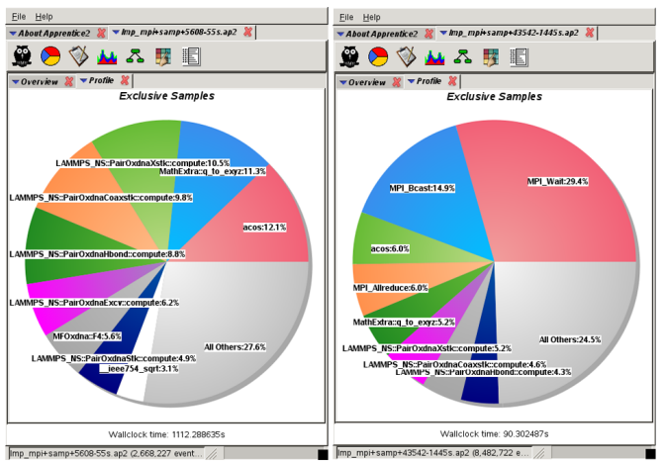
Quaternion to Cartesian Co-ordination Conversions
*
*Figure From:
Coarse-grained simulation of DNA using LAMMPS: An implementation of the oxDNA model and its applications. Eur. Phys. J. E, 41(5), 2018.

Slide 8
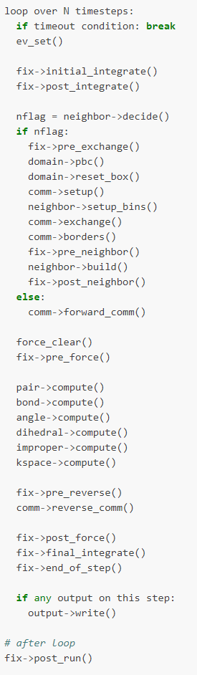
Quaternion to Cartesian Co-ordination Conversions
Breakdown of a timestep in
LAMMPS

Slide 9
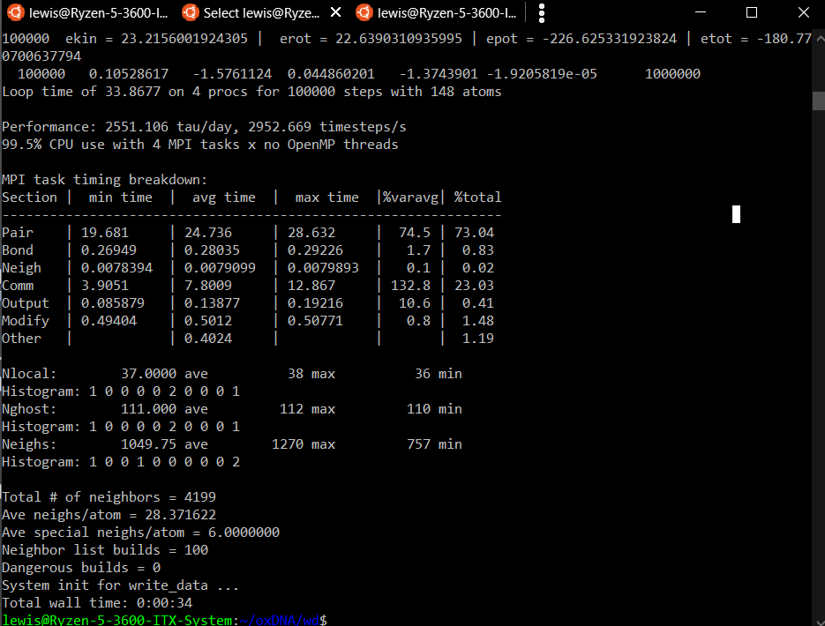
Quaternion to Cartesian Co-ordination Conversions
Original

Slide 10
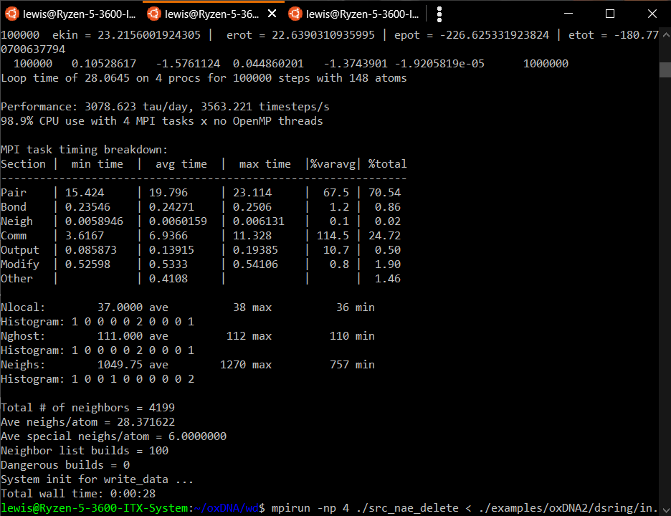
Quaternion to Cartesian Co-ordination Conversions
New:
28/34 = 0.824
So ~18% improvement!
https://github.com/lrussell676/lammps/tree/intpos/src

Slide 11
A Few Useful Links
https://www.lammps.org/
https://dna.physics.ox.ac.uk/index.php/Main_Page
https://docs.lammps.org/Packages_details.html#pkg-cg-dna
https://github.com/lammps/lammps/tree/develop/src/CG-DNA
.ppt here on my GitHub |
https://github.com/lrussell676/Public_Yr_4_Files/blob/main/PH450%20Talk.pptx

Slide 12
X THE PLACE OF USEFUL LEARNING

